Slide 1

Michael Franssen, Joris Geurts
Logic in Professional Practice: Semantic Tableaux

Slide 2
Proving propositions
assignment:
validate that a proposition is a tautology
can be done with truth tables; disadvantages:
exponential growth with variables
cannot deal with ∀ and ∃

Slide 3
Universe of propositions
is not always false
might be true
is not a contradiction
is a contradiction
tautologies
contradictions
P
¬P
is a tautology
is not a tautology
is not always true
might be false

Slide 4
Reductio ad absurdum
tautology
contradiction
prove a proposition with "reductio ad absurdum":
“if a proposition is never false, then it is always true”
in other words: ¬¬P ⇒ P
how to prove that P is never false?
show that ¬P is never true
show that ¬P is a contradiction!

Slide 5
Semantic tableaux (1)
a semantic tableau is a tree with a set in each node
the root contains { ¬P }
task to do: determine if ¬P is a contradiction (because: then P is a tautology)
a node can be extended with children which have simpler formulas (perhaps more)
if a set in a node contains formulas like X and ¬X, then it contains a contradiction; we can "close this node"
if all children contain a contradiction, then the parent node contains a contradiction as well; we can close the parent
if all nodes in a tree are closed then we are ready: ¬P is always False and so P is always True

Slide 6
Semantic tableaux (2)
start a tableau with the root containing set {¬P}
extend the tree by making new sets
in each new set, a formula is replaced by new formulas:
replace ¬¬P by P
replace (P⋀Q) by two new formulas P and Q
replace (P⋁Q) by two new sets; one with P and one with Q; each new set is a new child node
…
give the rules for: ¬(P⋁Q), ¬(P⋀Q), P⇒Q, ¬(P⇒Q),
P⇔Q, ¬(P⇔Q), P%Q, ¬(P%Q)
Notes:
exercises:
~(P & ~P)
~(P & Q)
~((P & ~P) | (P & Q))
~((P & ~P) | (Q & ~Q))

Slide 7
Tableau rules
¬¬P
double negation
P
P⋀Q
¬(P⋁Q)
¬(P⇒Q)
α-rules
P, Q
¬P, ¬Q
P, ¬Q
¬(P⋀Q)
P⋁Q
P⇒Q
β-rules
¬P | ¬Q
P | Q
¬P | Q
what to do with % and ⇔ ?

Slide 8
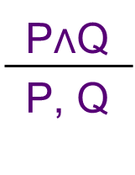
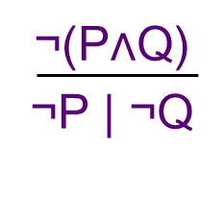
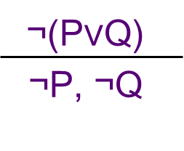
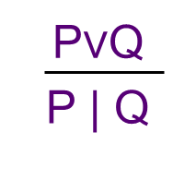
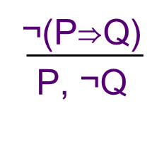
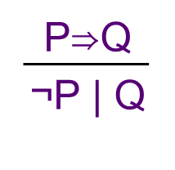
example
α-rules β-rules
{¬(((P⋁Q)⇒R)⇒((P⇒R)⋁(Q⇒R)) }
{ (P⋁Q)⇒R, ¬((P⇒R)⋁(Q⇒R)) }
{ (P⋁Q)⇒R, ¬(P⇒R), ¬(Q⇒R) }
{ (P⋁Q)⇒R, P, ¬R, ¬(Q⇒R) }
{ (P⋁Q)⇒R, P, ¬R, Q }
{¬(P⋁Q), P, ¬R, Q }
{R, P, ¬R, Q }
{¬P, ¬Q, P, ¬R, Q }
closed!
closed!
((P⋁Q)⇒R)⇒((P⇒R)⋁(Q⇒R))
is a tautology
Notes:
[in prefix: >(>(|(P,Q),R),|(>(P,R),>(Q,R))) ]
It seems that a ¬R disappears, but that's not the case: they are SETS and there was already a ¬R!
is tautology?
|(P,~(P)) 1 leaf, closed
&(P,~(P)) 2 leaves, both not-closed
~(>(|(P,~(P)),P)) 2 leaves, 1 closed, 1 not-closed
&(|(A,~(A)), |(B,~(B))) 2 leaves, both closed
&(&(>(A,A),|(B,~(B))),~(>(|(C,>(C,D)),|(&(A,C),D)))) 5 leaves; 3 closed, 2 not-closed

Slide 9
Tableaux for quantifiers
semantic tableaux can be extended with quantifiers
new rules: γ and δ
problem…: γ rules don't give simpler rules

Slide 10
Tableau rules for quantifiers
(∃ x.P)
¬(∀x.P)
δ-rules
P[x:=v]
¬P[x:=v]
for a new variable v
(∀x.P)
¬(∃x.P)
γ-rules
(∀x.P), P[x:=t]
¬(∃x.P), ¬P[x:=t]
for an existing variable t

Slide 11
the new rules
because γ rules do not remove the quantifier, you can apply them over and over
the tableau method doesn't end always
if implemented correctly, proving tautologies will end (although it might take thousands of years…)
this is called: semi-decidability (if a formula is a tautology, the method finishes in a finite amount of time, but you can't prove it for any formula)

Slide 12
implement tableaux with quantifiers
only formulas with bound variables
in each node: keep track of active variables (so initially: none)
apply the rules with priority:
α
δ
β
(finally) γ

Slide 13
apply the γ rule
a δ rule introduces a new variable
the γ rule: apply all existing variables on a formula (so you get a lot of new formulas)
then: apply α, β and δ again until no further possibilities exist
etc.

Slide 14
example
α-rules β-rules
{ ¬((∃x.(∀y.P(x,y)))⇒(∀q.(∃p.P(p,q)))) } [ ]
{ (∃x.(∀y.P(x,y))), ¬(∀q.(∃p.P(p,q))) } [ ]
{ (∀y.P(a,y)), ¬(∀q.(∃p.P(p,q))) } [a]
{ (∀y.P(a,y)), ¬(∃p.P(p,b)) } [a,b]
{ (∀y.P(a,y)), P(a,a), P(a,b), ¬(∃p.P(p,b)) } [a,b]
{ (∀y.P(a,y)), P(a,a), P(a,b), ¬(∃p.P(p,b)), ¬P(a,b), ¬P(b,b) } [a,b]
closed!
(∃x.(∀y.P(x,y))) ⇒ (∀q.(∃p.P(p,q)))
is a tautology
Notes:
>(!x.(@y.(P(x,y))),@q.(!p.(P(p,q))))
>(@q.(!p.(P(p,q))),!x.(@y.(P(x,y))))
@x.(!y.(P(x,y)))

